Slide 1
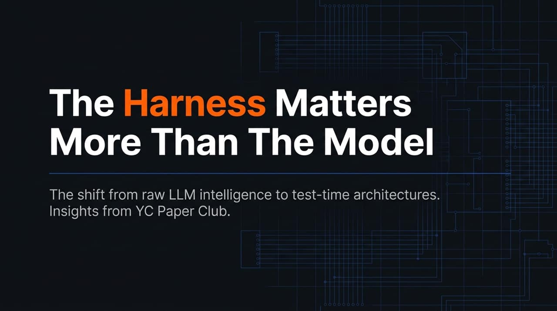
Notes:
Good morning/afternoon, everyone. Today we’re diving into one of the most critical paradigm shifts in modern Artificial Intelligence and Machine Learning engineering: the pivot from chasing raw LLM parameter size to building robust test-time agentic harnesses.
For the past two years, the industry narrative centered on raw model IQ: bigger foundation models, larger parameter counts, and massive pre-training runs. However, recent empirical breakthroughs show that how you wrap, orchestrate, and control a model during inference—its harness—dictates real-world capability.
Drawing insights from the YC Paper Club and recent state-of-the-art developments, we will explore why system architecture and test-time execution environments are outpacing pure weight-based intelligence.
https://www.youtube.com/watch?v=2d4u80LmRQ8

Slide 2
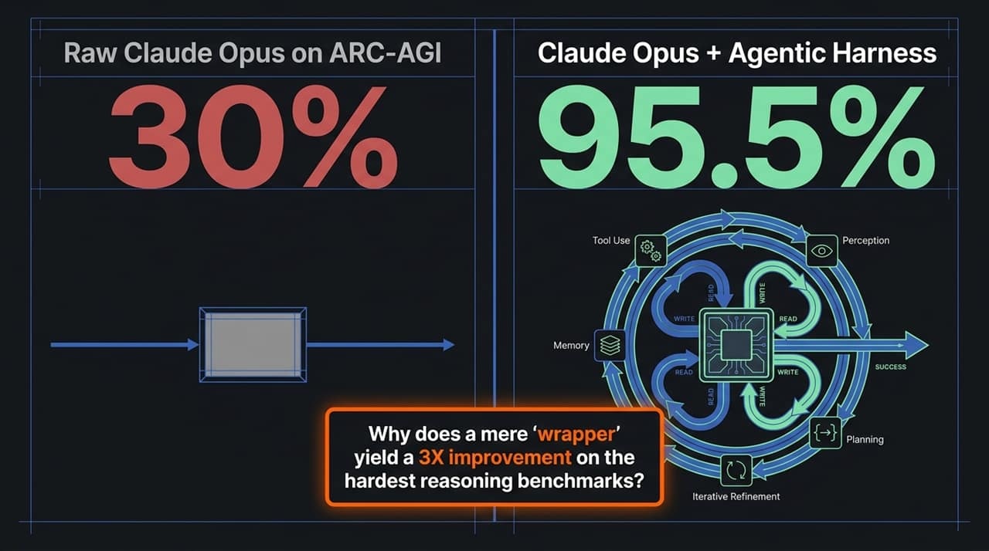
Notes:
To understand why the harness matters, look at these results on ARC-AGI—one of the hardest benchmarks for general intelligence and abstract reasoning.
When you feed ARC-AGI problems directly to raw Claude Opus in a single pass, it achieves a score of 30%. It hits a hard wall because single-pass inference relies solely on static weights.
However, when you place that exact same Claude Opus model into an advanced agentic harness, the benchmark score jumps to 95.5%—more than a 3x increase without modifying a single parameter in the foundation model!
How does this happen? The harness provides an execution loop: it acts as a perceptual engine, breaks complex problems into iterative steps, provides external working memory, enables tool execution, and allows the model to self-correct and refine its answer before outputting a final result.

Slide 3
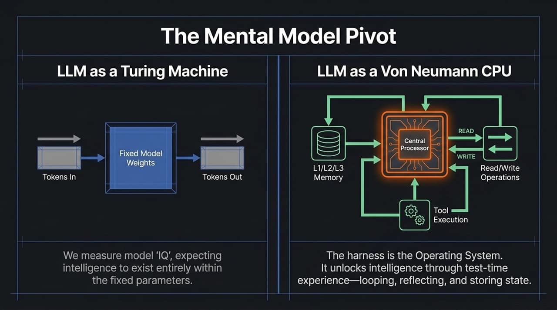
Notes:
We need to update our mental model of Large Language Models.
Historically, we treated LLMs like a static Turing machine or function: feed tokens in, run through fixed model weights, get tokens out. We measured 'model IQ' as if intelligence existed solely within static parameter weights.
The new paradigm treats the LLM as a Von Neumann CPU. The weights are simply the central processor unit. The harness represents the surrounding Operating System—managing L1/L2/L3 memory caches, read/write I/O operations, and tool invocation.
Intelligence is not static in the weights; it emerges dynamically through the OS layer via test-time loops, memory state retention, and reflection.

Slide 4
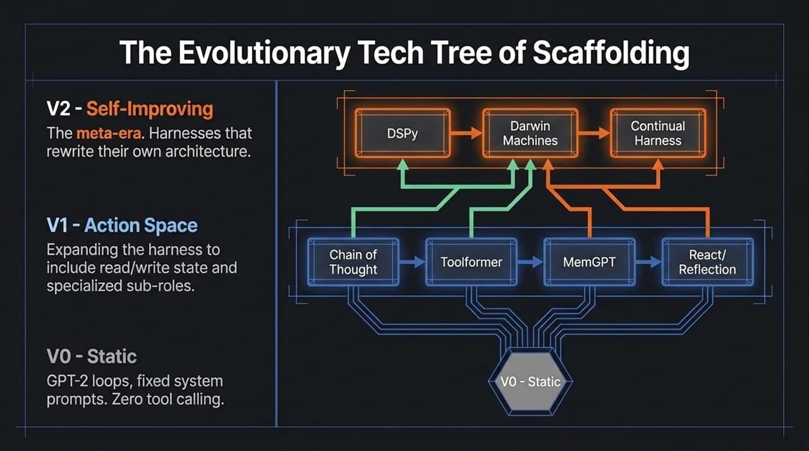
Notes:
Agent scaffolding evolved through three distinct evolutionary generations:
V0 (Static Era): Fixed prompt templates and zero tool access. The model executed in a single shot without dynamic adaptability.
V1 (Action Space Era): We introduced dynamic reasoning loops—Chain of Thought, tool integration (Toolformer), dedicated state management (MemGPT), and ReAct framework loops. This unlocked multi-step problem solving.
V2 (Self-Improving Meta Era): The current frontier. Harnesses like DSPy and Darwinian meta-architectures optimize their own prompts, workflows, and code logic dynamically at test-time.

Slide 5
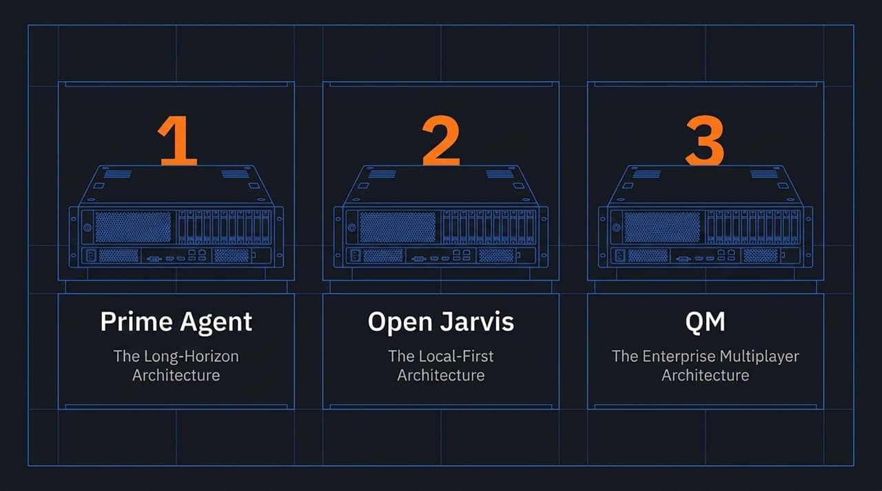
Notes:
To implement agentic systems practically, three primary architectural patterns have emerged to solve specific operational constraints:
1. Prime Agent: Built for long-horizon execution spanning multi-day tasks, massive token budgets, and hundreds of sub-agents.
2. Open Jarvis: Designed for local-first, privacy-focused execution running on consumer-grade workstation hardware.
3. QM: Targeted at enterprise-grade multiplayer workflows, breaking centralized compute sandboxes to share context safely.

Slide 6
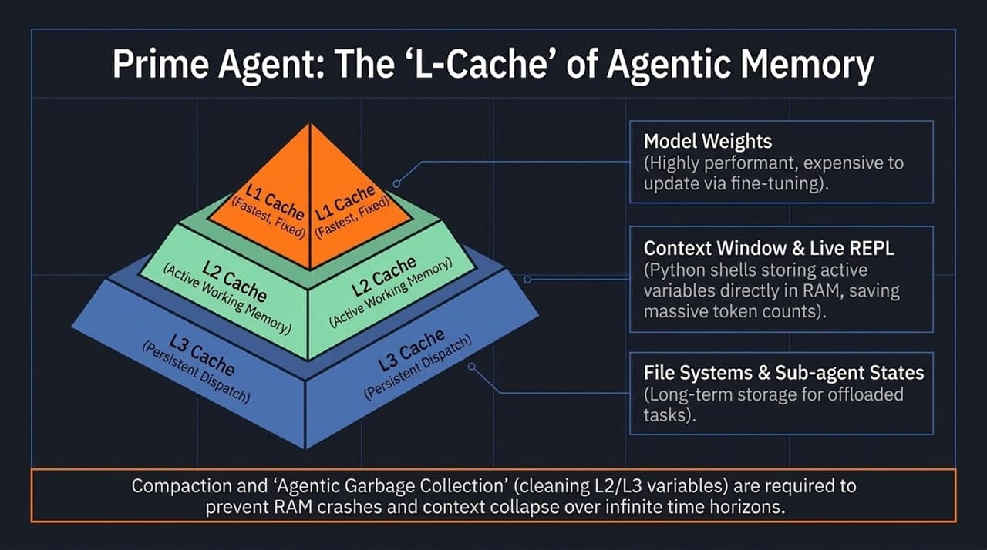
Notes:
Long-running agents face a major challenge: context collapse and memory overload over continuous execution.
Prime Agent solves this with an L-Cache memory structure:
L1 Cache: Model weights—static, highly performant, expensive to update.
L2 Cache: Active working memory—live context window and Python REPL runtime state saving token overhead.
L3 Cache: Persistent storage—file systems and dormant sub-agent states for long-term offloading.
Crucially, the harness performs Agentic Garbage Collection—pruning unnecessary state from L2/L3 memory so the model can run indefinitely without crashing RAM or losing context focus.

Slide 7
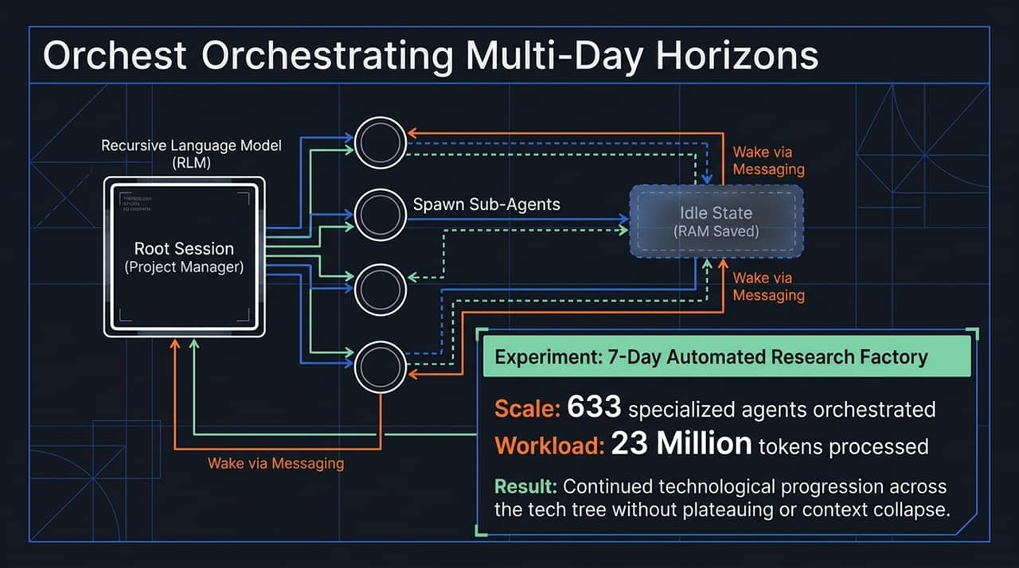
Notes:
Here is an empirical demonstration of the L-Cache framework in action: a 7-Day Automated Research Factory experiment.
A Root Session project manager dynamically spawns specialized sub-agents. Instead of keeping every sub-agent active in memory—which would quickly exhaust context limits—dormant sub-agents are placed in an Idle State (saving RAM) and woken up via targeted messaging triggers only when required.
Over seven days, the system orchestrated 633 sub-agents and processed 23 million tokens without hitting context collapse or degrading reasoning quality.

Slide 8
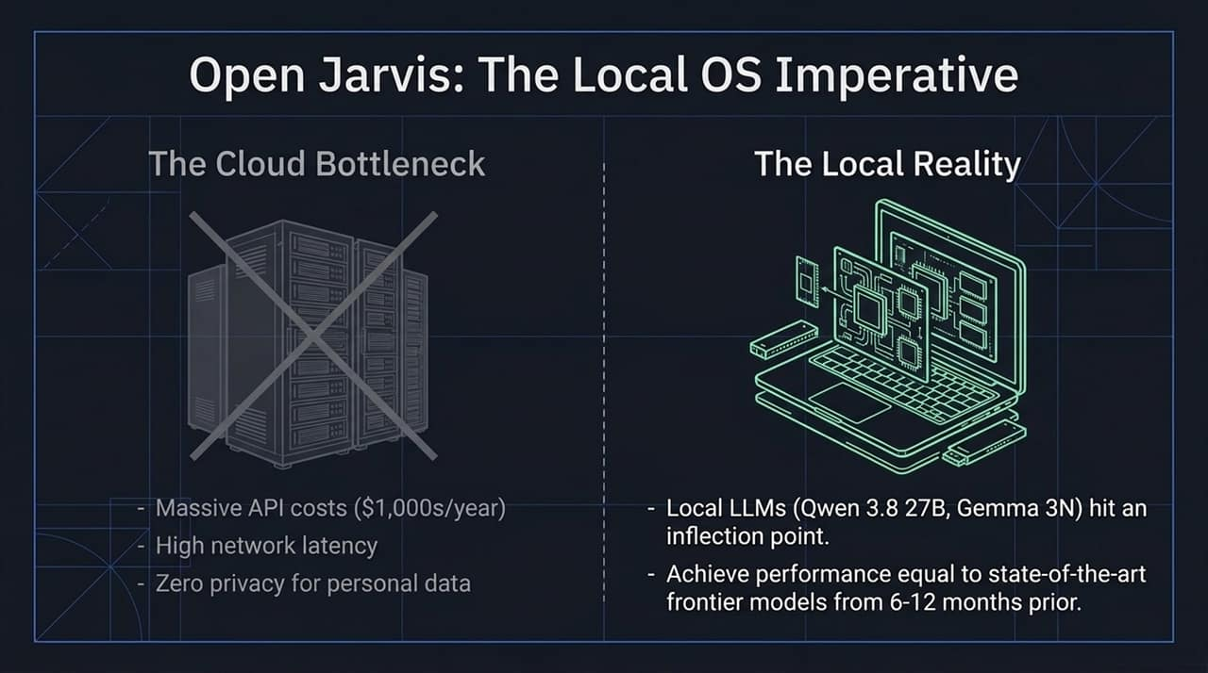
Notes:
The second architectural pattern addresses the Cloud Bottleneck.
Relying purely on cloud APIs presents major friction: spiraling token costs, latency delays across network roundtrips, and substantial data privacy risks when handling personal files or enterprise codebases.
Smaller local open-weights models (like Qwen and Gemma variants) have crossed a performance threshold, matching the capabilities of frontier cloud models from just 6–12 months ago.
When paired with an efficient local harness, these models run rapidly directly on consumer devices.

Slide 9
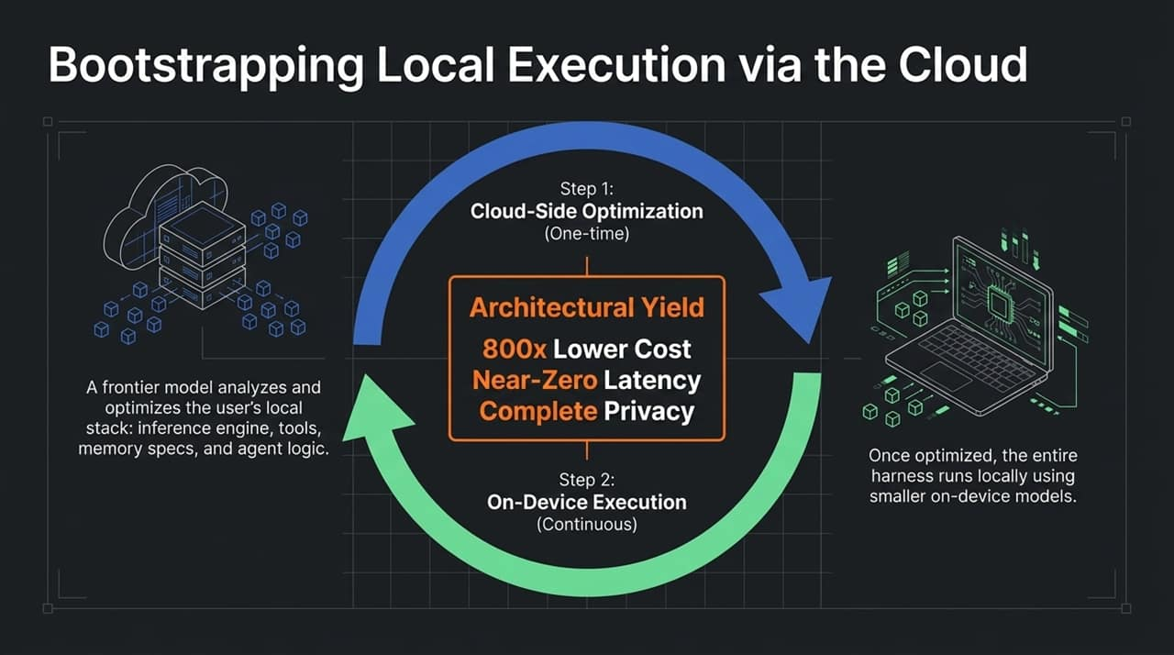
Notes:
Open Jarvis uses a hybrid two-step strategy called Cloud Bootstrapping.
Step 1: A powerful cloud frontier model performs a single, one-time analysis of the local environment—configuring parameters, tools, memory allocation, and agent workflow scripts tailored to the user's hardware.
Step 2: Execution transitions entirely to the local device. The local harness runs continuously on smaller local models.
This hybrid setup delivers 800x cost reductions, sub-millisecond execution latency, and total local data privacy.

Slide 10
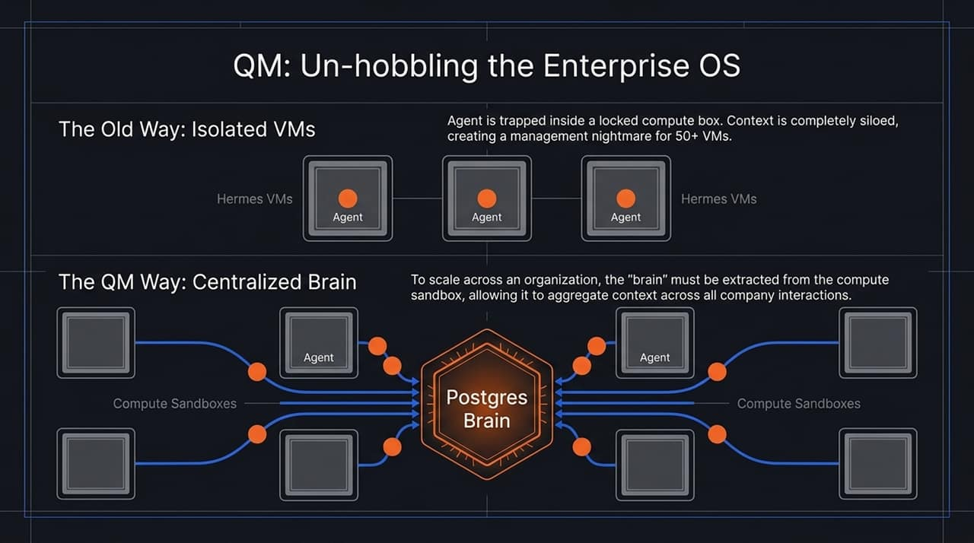
Notes:
In enterprise settings, deployment usually hits a barrier around compute sandboxing.
The Old Way: Assigning isolated agents into locked virtual machines creates context silos. If you run 50 different VMs, knowledge remains trapped inside individual instances, causing a management nightmare.
The QM Approach: Decouple the intelligence from the compute engine. QM establishes a Centralized Postgres Brain that aggregates knowledge, memory, and history across all organizational interactions, while using isolated sandboxes strictly for execution.

Slide 11
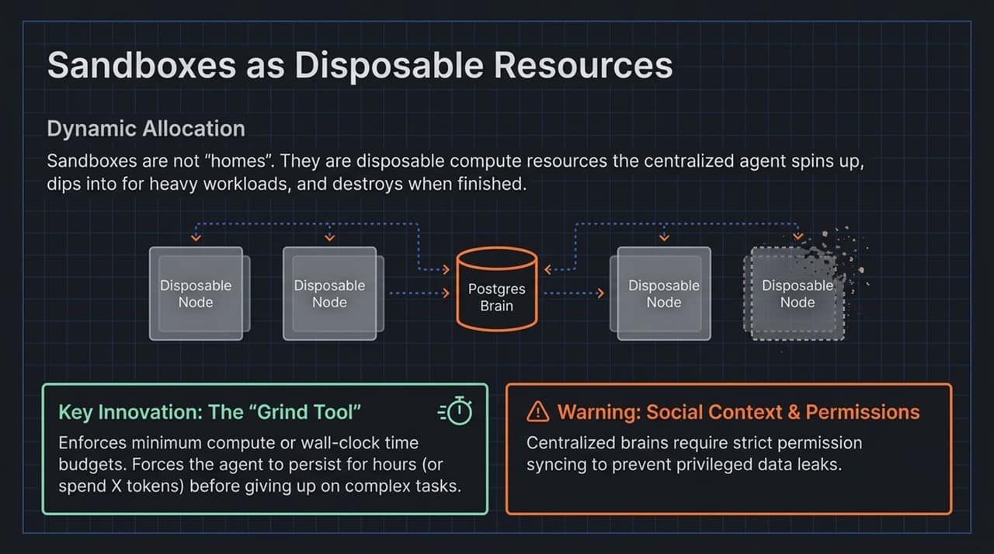
Notes:
Under QM, sandboxes are no longer static homes for agents—they are disposable compute nodes. The central brain spins up a node, executes a heavy task, and destroys the container immediately.
A key technical innovation introduced here is the Grind Tool. Standard LLMs often give up prematurely on hard tasks. The Grind Tool sets mandatory minimum compute time or token expenditure budgets, forcing the agent to iteratively attempt solutions for hours until the goal is achieved.
Note: Because context is centralized, strict role-based access control (RBAC) must be synced across the brain to prevent unintended privilege escalation.

Slide 12
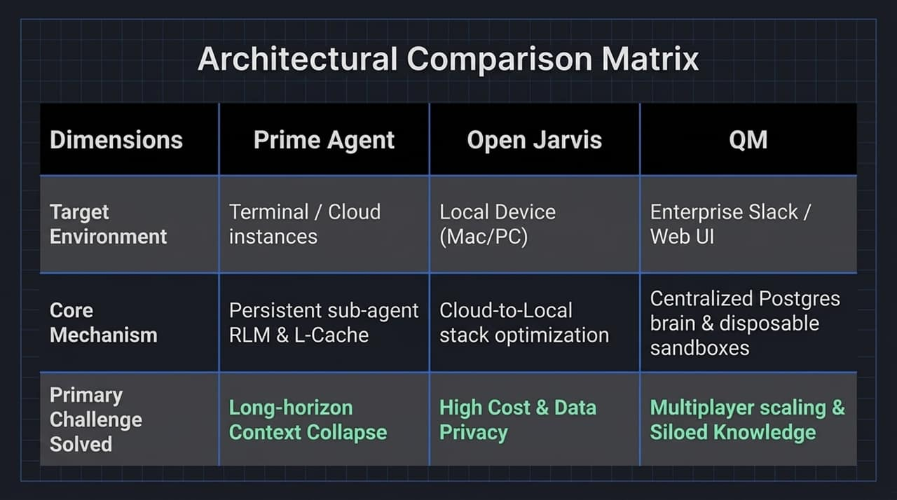
Notes:
Here is a comparative summary of the three architectural paradigms:
Prime Agent targets deep research and long-horizon execution in cloud/terminal environments, solving context collapse via L-Cache structures.
Open Jarvis optimizes local workstation execution, eliminating high API costs and privacy concerns through cloud bootstrapping.
QM scales enterprise multiplayer workflows by combining a central shared memory brain with disposable worker sandboxes.

Slide 13
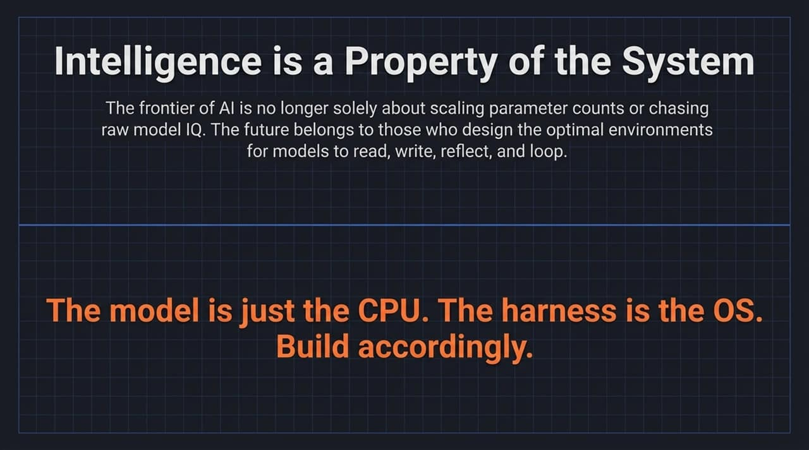
Notes:
To conclude: raw parameter scaling is yielding diminishing relative returns on complex, multi-step tasks compared to test-time harness design.
The future of AI application engineering belongs to system designers who build optimal environments for models to read, write, reflect, loop, and persist state.
Remember this core principle: The model is just the CPU. The harness is the Operating System. Build accordingly.

Slide 14
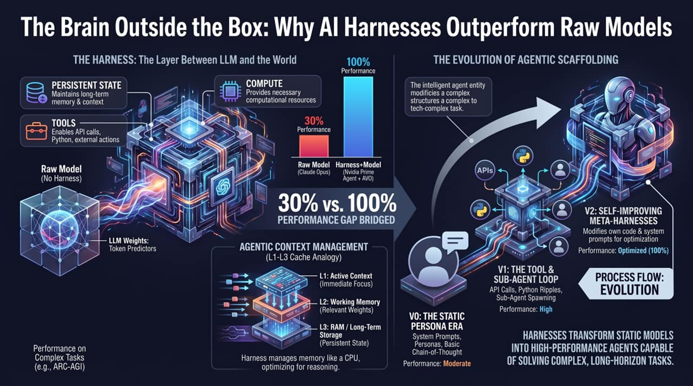
Notes:
This final slide brings together the entire architectural ecosystem:
The harness serves as the indispensable bridge between pure token prediction and real-world execution. By pairing fixed weights with Persistent State, Tool APIs, and Managed Compute, we bridge the gap between 30% baseline single-pass performance and near-complete task execution.
As we move from simple system prompts (V0) to tool loops (V1) and self-optimizing meta-harnesses (V2), structuring these environment systems will remain our highest-leverage engineering focus.

